Slide 1
Evolutionary Mechanisms
Chapter 14

Slide 2
Gene pools
Population – group of the same species living together in a particular place at a particular time
Gene pool – sum of all alleles in a population
Allele frequency – how often an allele occurs in a gene pool
Allele frequency for the alleles for blue eyes in a Scandinavian population is greater than that of an African population. Vice versa for brown eyes

Slide 3
Variation of between individuals within a population
Random assortment
Crossing over
Non-disjunction
Random Fertilisation
Mutations
Gene and chromosomal
Somatic and germline

Slide 4
Changes to allele frequencies in gene pools
Natural selection
When nature favours a set of alleles at the expense of others (selection pressure)
Over a number of generations, you would expect the allele frequency for favoured alleles to increase
Not random and a major cause of changes to allele frequencies

Slide 5
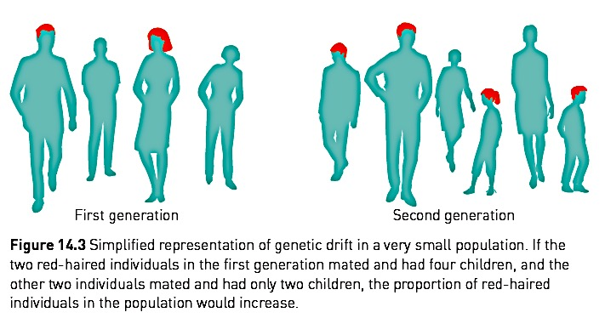
Changes to allele frequencies in gene pools
2. Random Genetic Drift
Small populations often have random variation in allele frequencies
Occurs purely by chance

Slide 6
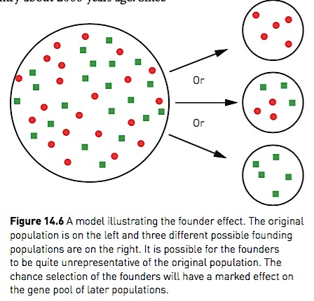
Changes to allele frequencies in gene pools
Founder effect
Similar to random genetic drift
Small group moves to a new area and establishes a community which expands
Migrant population unlikely to be genetically representative of original population
Show traits which are not typical of original population

Slide 7
Changes to allele frequencies in gene pools
3. Migration
Migration – gene flow from one population to another
If immigrants bring alleles that are not already in the population, then the allele frequencies for that gene will be altered
E.g.
China’s population all had Rh+ blood. Europeans migrated to China. Brought Rh- allele to the country and changed the allele frequencies for the Rhesus factor gene.

Slide 8
Changes to allele frequencies in gene pools
4. Barriers to gene flow
Populations often kept apart by barriers that inhibit interbreeding between them
Different environments mean different selection pressures, resulting in different alleles being favoured and therefore different allele frequencies
Geographical barriers: oceans, mountains, deserts
Sociocultural barriers: economic status, religion, social position, educational background

Slide 9
Changes to allele frequencies in gene pools
5. Genetic disease
Genetic disease leads to changes in allele frequency – an allele causing a fatal disease would be expected to be gradually eliminated
Tay-Sachs disease (TSD)
Hereditary disorder of lipid metabolism, occurs most frequently in Ashkenazi Jewish people – death occurs around 4-5yo
Worldwide frequency is 1:500 000. In Jewish populations 1:2 500
Thought to be caused by genetic drift
Due to discrimination, Ashkenazi Jews found themselves in overcrowded ghettos, increasing chance of TB
Heterozygous individuals are resistant to Tuberculosis (TB)

Slide 10
Evolution through natural selection
Evolution
Gradual change in the characteristics of a species over time
Natural selection
Theory proposed by Charles Darwin

Slide 11
Natural selection
Thomas Malthus demonstrated:
Natural reproduction rates exceeded the available resources
More plants and animals are produced than can possibly survive
Charles Darwin realised:
Under these circumstances, a struggle for existence would occur

Slide 12
Natural selection
Based on 3 observations:
Variation: Members of a species vary and these variations are passed on to offspring
Birth rate: Living organisms reproduce at a far greater rate than that at which their food and resource supply will support. Results in overcrowding
Nature’s balance: Although birth rate is high, the number of each species are maintained at a relatively constant level

Slide 13
Natural selection
Darwin realised that:
There must have been a struggle for existence
Those with characteristics best suited to their environment are more likely to survive (survival of the fittest)
Survival of the fittest is possible because of variation in a species

Slide 14
Natural selection
Over time, the characteristics of a population changes so it becomes better suited to its environment
Where environments are changing, characteristics that enhance survival will enable surviving generations to gradually adapt to it
Adaptations take many, many generations to develop
Natural selection and allele frequencies If the environment favours a particular characteristic, then frequency for this alleles will increase, over time

Slide 15
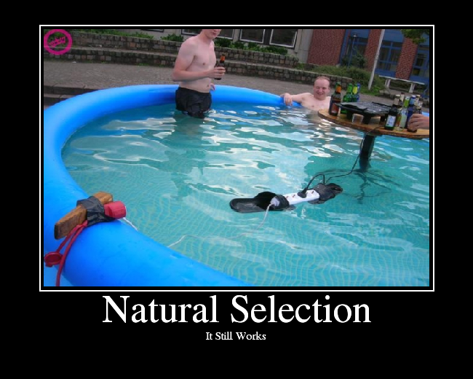

Slide 16
Natural selection case study: Sickle cell anaemia
Disease that causes red-blood cells to have a sickle shape
Causes person to experience dizziness, shortness of breath, due to lack of oxygen
Disease is usually fatal in homozygote recessive individuals (ss)

Slide 17
Natural selection case study: Sickle cell anaemia
The heterozygote (Ss) has some sickled cells and some normal RBC
Ss individuals are more resistant to malaria than homozygote normals (SS)
Malaria is said to be a selective agent for the sickle-cell allele

Slide 18
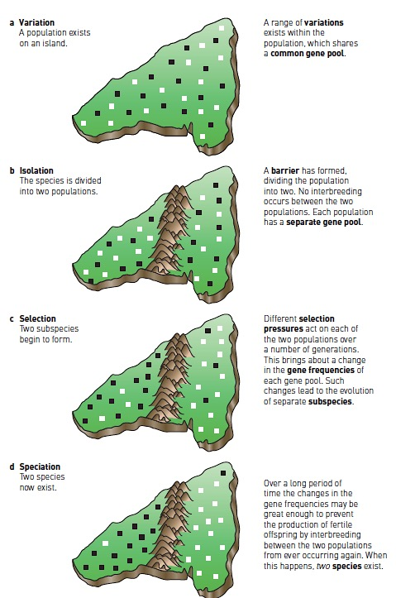
Speciation
Variation
Exists within a population sharing a common gene pool
Isolation/barrier to gene flow
Leads to reproductive isolation (no interbreeding)
Now are populations with separate gene pools
Selection
Different selection pressures act on each population
Favouring different alleles and thus changing allele frequencies
Changes lead to the evolution of subspecies
Speciation
Over many generations
Interbreeding is no longer possible due to a great difference in gene frequencies

Slide 19
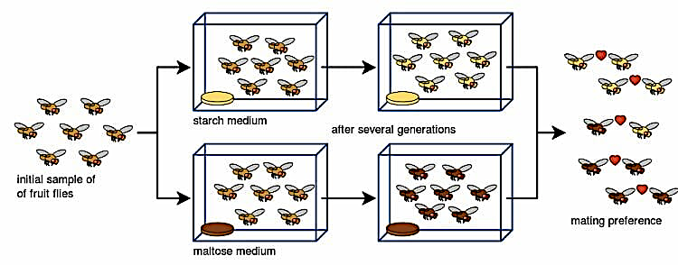
Speciation

